Slide 1
Data science
Text Mining & Search Project
Classification and clustering of IMDB dataset
CdL Data Science a.a. 2021/2022
Matteo Cesaro 867350
Francesco Martinelli 873685
Cristiano Ruttico 809360

Slide 2
Università degli Studi di Milano-Bicocca | CdL Data Science a.a. 2021/2022
Index
Introduction
Dataset
Preprocessing
Classification
Clustering
Conclusions

Slide 3

Università degli Studi di Milano-Bicocca | CdL Data Science a.a. 2021/2022
Introduction
In recent years, the activity of texting data on the internet has increased dramatically.
As a matter of fact, there are several websites available where anyone can post comments after watching a movie, using a product, or reading a book.
These comments can be analyzed through NLP or text mining in order to better understand people’s opinion or feeling about everything.
The main purpose of this study is to analyze the reviews on IMBD.

Slide 4
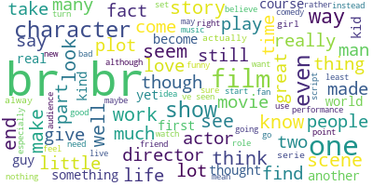
Università degli Studi di Milano-Bicocca | CdL Data Science a.a. 2021/2022
Dataset
IMDB is the largest movie website globally and its archive contains over 150 million movie reviews.
For this analysis, the IMDB dataset available at the following website ‘http://ai.stanford.edu/~amaas/data/sentiment/’ is considered.
The dataset consists of 50,000 movie reviews divided into two different directories: training set and test set. Each movie review is saved as a txt file.
Both training set and test set are also split into negative reviews and positive reviews.

Slide 5
Università degli Studi di Milano-Bicocca | CdL Data Science a.a. 2021/2022
Preprocessing 1/2
Normalization
Text data contains noise in various forms like emoji, punctuation or numbers, therefore removing the noise is essential.
First of all, lower case and upper case are treated differently by a text mining algorithm, so it is necessary to transform each review to a fully lower structured sentence.
Another text processing technique is removing punctuations.
Secondly, English Stopwords are removed from each file.
To remove numbers, Urls and emojis might make sense, since no valuable information about the task of classifying and clustering positive and negative film reviews is contained.

Slide 6
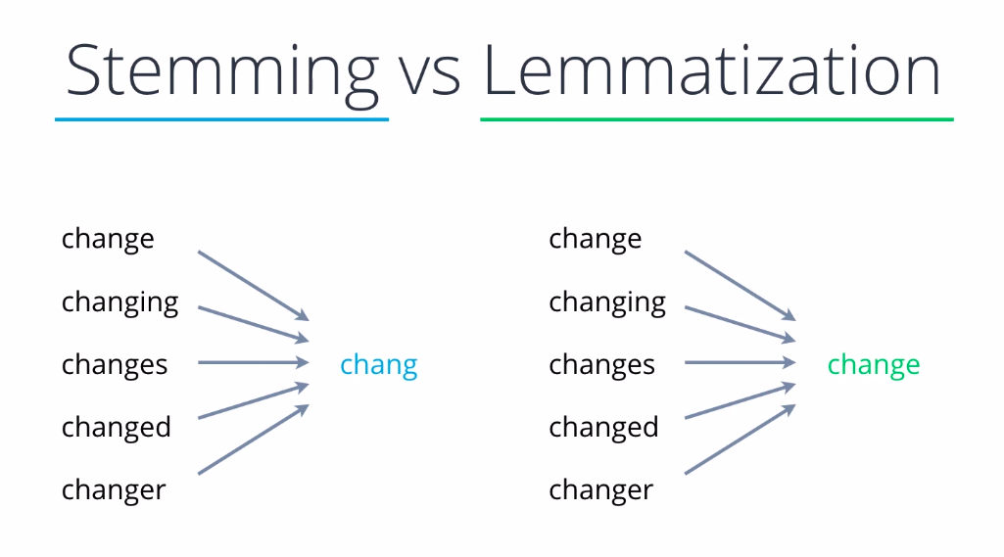
Università degli Studi di Milano-Bicocca | CdL Data Science a.a. 2021/2022
Preprocessing 2/2
Tokenization
It consists in separating chunks of text into smaller units called tokens.
For this purpose, Whitespace Tokenizer, NLTK Word Tokenizer and Punct based are used.
Stemming or Lemmatization
Both are used for this analysis in order to compare the performance with each other.
Stemming and lemmatization aimed at reducing the inflectional forms of each word into a common base or root (but, in a different way).

Slide 7
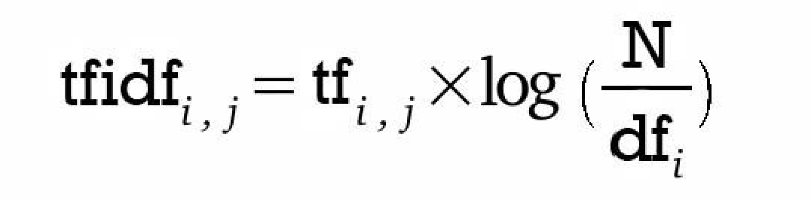
Università degli Studi di Milano-Bicocca | CdL Data Science a.a. 2021/2022
Text Representation
For this study, TF-IDF approach is used.
TF: considers how important a word may be through term frequency, without including stop words already removed.
IDF: since TF often incorrectly emphasizes documents which use more frequently word with no valuable information, IDF decreases the weight of this types of word and increases the weight for other less used words.
This combination is called TF-IDF and it describes the frequency of a term adjusted for how rarely it is used.

Slide 8
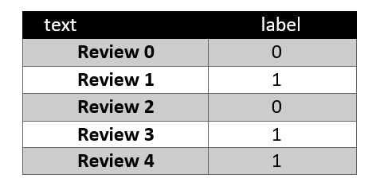
Università degli Studi di Milano-Bicocca | CdL Data Science a.a. 2021/2022
Classification
The aim of this part of the project is to perform the classification task; in particular our goal is to train some algorithms to learn to discriminate between positive and negative IMDB reviews.
In particular, data were in the form of a table, showing the following structure:
The ‘0’ label indicates that the review is positive, the ‘1’ value indicates instead that it is negative.

Slide 9
Università degli Studi di Milano-Bicocca | CdL Data Science a.a. 2021/2022
Preprocessing
Class distribution was already balanced, so no balancing steps were necessary.
The dataset was splitted in training and test using a 75-25 % splitting.
In order to apply algorithms we represented data at our disposal using Bag of Words representation.
‘tf-idf’ weighting system was used.
Our data are now ready to be fed to models

Slide 10
Università degli Studi di Milano-Bicocca | CdL Data Science a.a. 2021/2022
Models and evaluations
The models chosen belong to different classes, in particular we have the following:
Decision Tree
Random Forest
Logistic Regression
SVM
AdaBoost
Different evaluation measures were taken into account: in particular we utilized Accuracy, Precision, Recall, F1-measure, ROC.

Slide 11
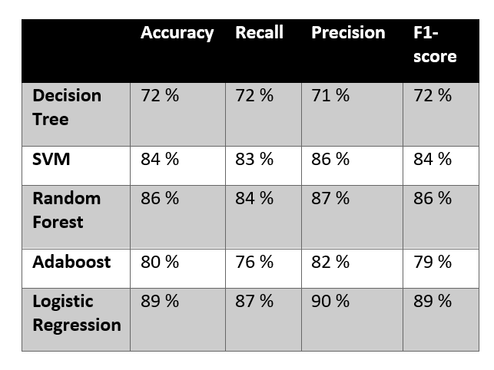
Università degli Studi di Milano-Bicocca | CdL Data Science a.a. 2021/2022
Results analysis
The results obtained by training the various models were quite satisfactory; below are the results obtained by applying only a whitespace tokenization, taking into account both uni-grams and bi-grams.
Since we are in the presence of balanced classes, the value we are interested in is the accuracy.
We tried performing our task on also lemmatized and stemmed data, we have also tried different tokenization techniques jointly with porter stemming but we obtained similar results, so they are not displayed.

Slide 12
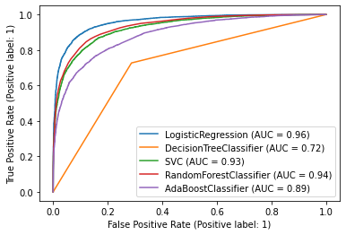
Università degli Studi di Milano-Bicocca | CdL Data Science a.a. 2021/2022
Results analysis
In order to provide a graphical comparison between models we provide ROC curves.
We denote that Logistic Regression performs better than others models; instead, Decision Tree classifier and AdaBoost perform poorly.

Slide 13
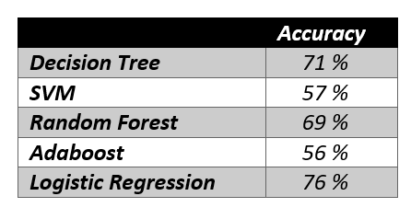
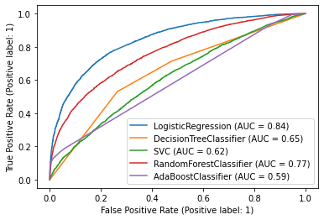
Università degli Studi di Milano-Bicocca | CdL Data Science a.a. 2021/2022
Results analysis
In order to try to obtain better results, we tried to modify the ngram_range parameter of the TfidfVectorizer method: in particular, we tried to use only tri-grams.
Here we report our accuracy and ROC results:
We denote that Logistic Regression still performs better than others models; instead, SVM and AdaBoost perform poorly.

Slide 14
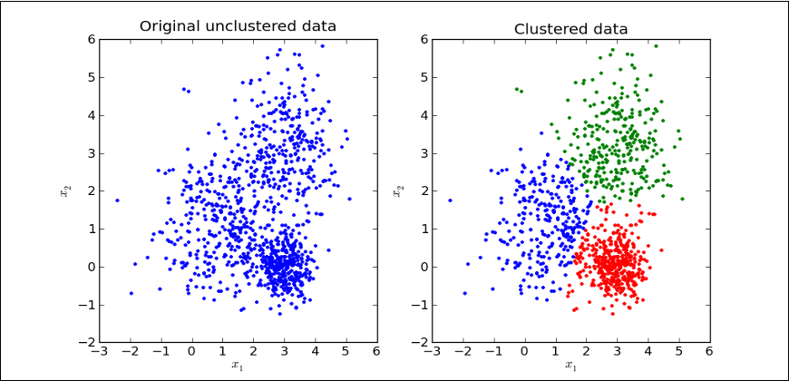
Università degli Studi di Milano-Bicocca | CdL Data Science a.a. 2021/2022
Clustering
Clustering is the most popular method of unsupervised learning, i.e., learning with unlabeled data. In this case, hard clustering will be used.
The goal of clustering is to divide documents into groups (clusters) in which:
Documents within the same cluster are as similar as possible
Documents in different clusters are as different as possible
The concept of similarity is addressed with mathematical measures of calculating the distance between vectors (Euclidean distance or cosine similarity for example).

Slide 15
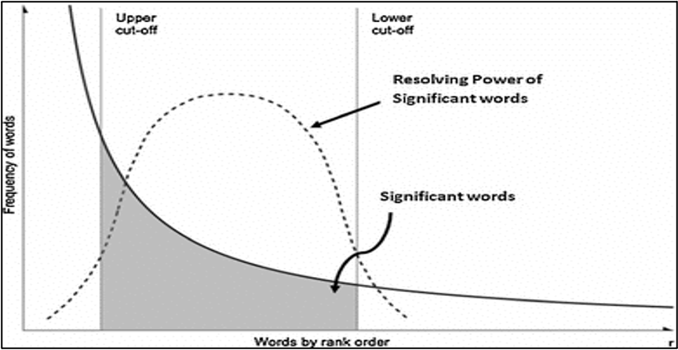
Università degli Studi di Milano-Bicocca | CdL Data Science a.a. 2021/2022
Tf-Idf Representation
The clustering algorithms have been implemented also in this case on a Tf-Idf representation.
Given the high computational cost of the processes, it was decided to cut some words considered not significant.
For this purpose, we adopted the concept of Luhn's analysis applied to the Zipf's Curve: the words present in more than 97% of the documents and in less than 3% were eliminated, as they were considered uninformative and discriminative.

Slide 16
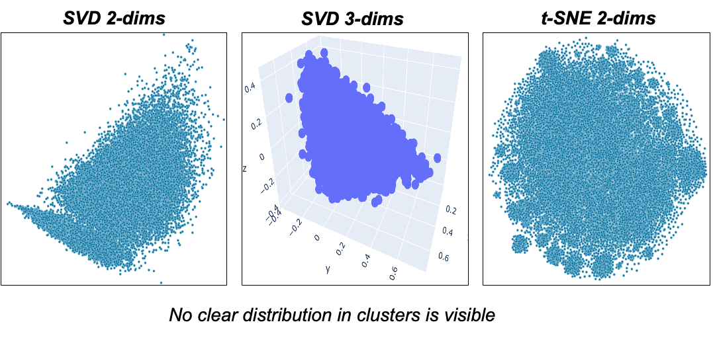
Università degli Studi di Milano-Bicocca | CdL Data Science a.a. 2021/2022
Data Visualization
Many of the clustering algorithms do not automatically compute the number of clusters which optimizes the goodness of clusters.
Visualizing the data attempts to identify a priori the best number of clusters.
Given the high dimensionality to visualize the data, the use of dimensionality
reduction methods (word embedding) is necessary.

Slide 17
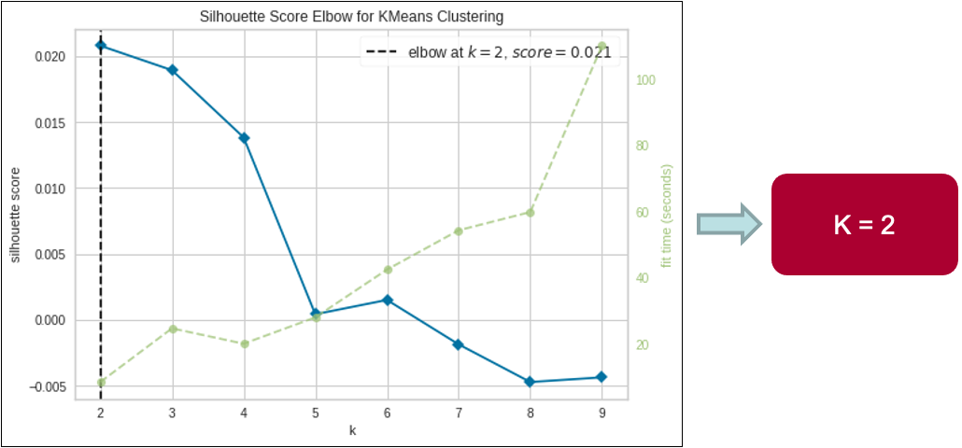
Università degli Studi di Milano-Bicocca | CdL Data Science a.a. 2021/2022
Number of Clusters
A brute force method is implemented to identify the best number of clusters.
We show the result of the KElbowVisualizer, which computed the Silhouette Score of K-Means clustering on data with K = [1, 10].

Slide 18
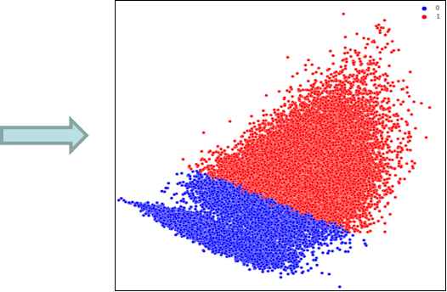
Università degli Studi di Milano-Bicocca | CdL Data Science a.a. 2021/2022
K-Means Clustering
K-Means clustering is an algorithm for flat clustering with a top-down approach.
The K-Means starting from K centroids computes the distance between document and centroid and assigns each observation to the cluster of the nearest centroid, after which it computes a new centroid as the average of the observations in the cluster and repeats the process until the stop condition is satisfied.

Slide 19
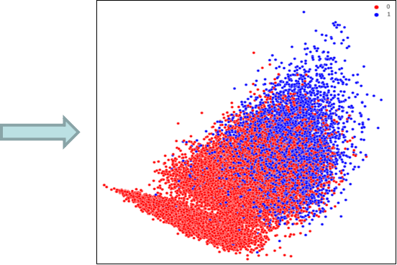
Università degli Studi di Milano-Bicocca | CdL Data Science a.a. 2021/2022
Agglomerative Clustering
Agglomerative clustering is an algorithm for hierarchical clustering with a bottom-up approach.
Only 35,000 of the 50,000 documents were used.
Agglomerative clustering starts from individual documents and gradually computes the distance between observations and/or clusters and merges those with the smallest distance until the desired K is reached.

Slide 20
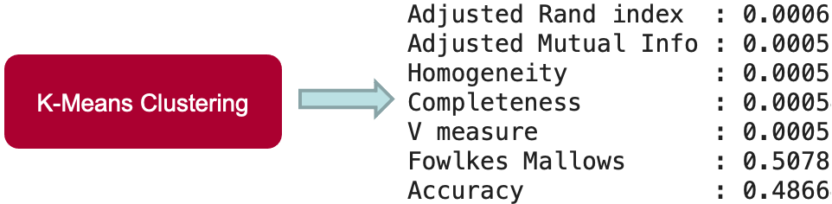
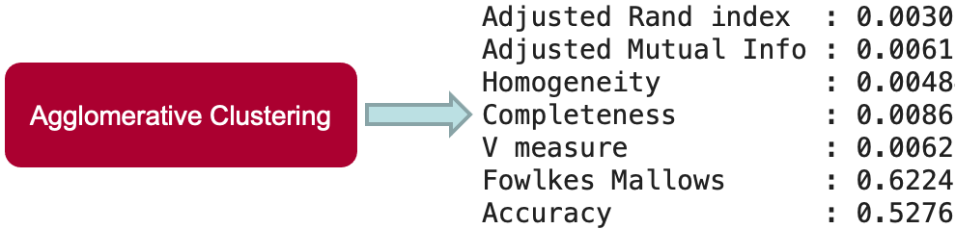
Università degli Studi di Milano-Bicocca | CdL Data Science a.a. 2021/2022
Evaluation
Below shows the performance of the two methods with some of the main measures for cluster evaluation.

Slide 21
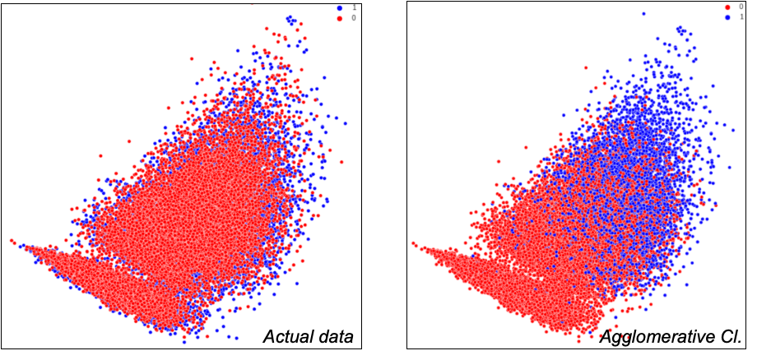
Università degli Studi di Milano-Bicocca | CdL Data Science a.a. 2021/2022
Results Analysis
In both cases the results are disappointing.
In detail, agglomerative clustering seems to perform slightly better, however the values are not such that they can be considered adequate.
The performance clearly indicates clustering similar to random selection, offering values around 0 and 50% depending on the measures.

Slide 22
Università degli Studi di Milano-Bicocca | CdL Data Science a.a. 2021/2022
Conclusions
Pre-processing
NER, POS
Word Embedding
To reduce the sparsity of the matrix and calculate more efficient features
Feature Selection
Using only significant features

